Slide 1
Electrical Engineering (UEE001)
Department of Electrical and Instrumentation Engineering
Thapar Institute of Engineering and Technology, Patiala

Slide 2
Unit I DC Circuits
Kirchhoff’s voltage and current laws;
power dissipation;
Voltage source and current source;
Mesh and Nodal analysis;
Star-delta transformation;
Superposition theorem;
Thevenin’s theorem; Norton’s theorem;
Maximum power transfer theorem;
Millman’s theorem and Reciprocity theorem;
Transient response of series RL and RC circuits.

Slide 3
Content
Electrical Network
Passive Element
Active Element
Bilateral Element
Unilateral Element
Meaning of Response
Linear and Non-linear Circuits
Network Basics (KCL and KVL)

Slide 4
Circuit definitions
Electrical Network: A combination of various electric elements (Resistor, Inductor, Capacitor, Voltage source, Current source) connected in any manner what so ever is called an electrical network.
Node: A node is a junction where two or more circuit elements are connected together. (N)
Independent nodes = N-1
Branch: An element or number of elements connected between two nodes constitutes a branch. (E)
Loop: A loop is any closed part of the circuit. (E-N+1)
Mesh: A mesh is the most elementary form of a loop and cannot be further divided into other loops. All the mesh are loops but all the loops are not meshes.

Slide 6
Example
How many nodes, branches & loops ?
R₁
+
-
I_{s}
Vs
R₂
R₃

Slide 7
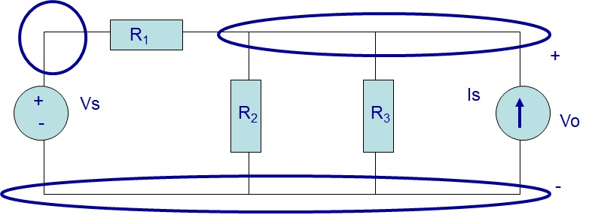
Three nodes

Slide 8
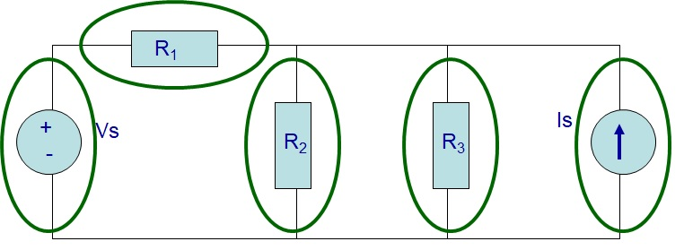
Five branches

Slide 9
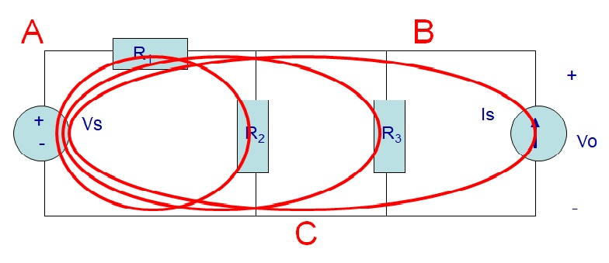
Three loops

Slide 10
Passive Vs. Active
Passive Element: The element which receives energy (or absorbs energy) and then either converts it into heat (R) or stored it in an electric (C) or magnetic (L) field is called passive element.
Active Element: The elements that supply energy to the circuit is called active element. Examples of active elements include voltage and current sources, generators, and electronic devices that require power supplies.

Slide 11
Meaning of Response
An application of input signal to the system will produce an output signal.
The behaviour of output signal with time is known as the response of the system.

Slide 12

Bilateral Vs Unilateral
Bilateral Element: Conduction of current in both directions in an element (example: R; L; C) with same magnitude is termed as bilateral element. Response of circuit remains the same.
Unilateral Element: Conduction of current in one direction is termed as unilateral (example: Diode, Transistor) element.

Slide 13
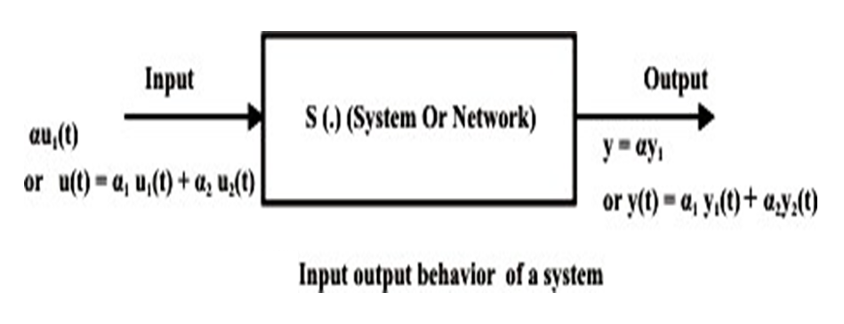
Linear and Non-linear Circuits
Linear Circuit: Roughly speaking, a linear circuit is one whose parameters do not change with voltage or current. [Y = m.X]
Homogeneity Property and Additivity

Slide 14
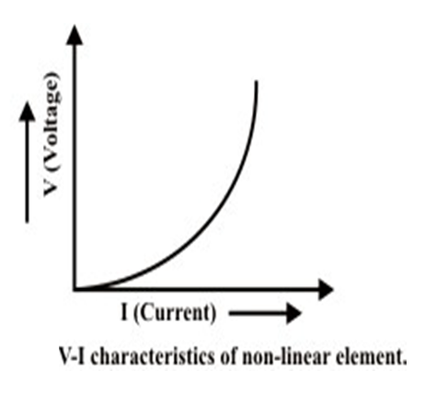
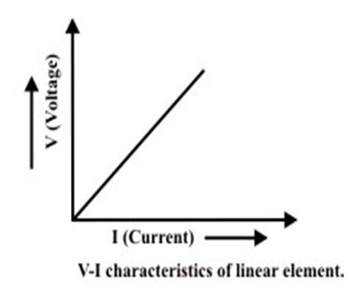
Linear and Non-linear Circuits
Non-Linear Circuit: Roughly speaking, a non-linear system is that whose parameters change with voltage or current. [Y = a.X²]

Slide 15
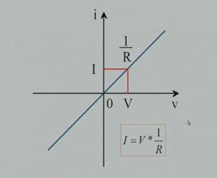
Resistor as a linear element

Slide 16
Network Basics
What is the potential difference?
The voltage or potential energy difference between two points in an electric circuit is the amount of energy required to move a unit charge between the two points.
What is the direction of the current?
Positive direction of current is from a point of higher potential to the point of lower potential

Slide 17
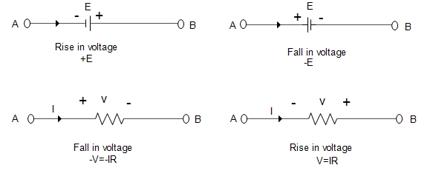
Notations of Voltage
A Rise in voltage is associated with Source
A drop in voltage is associated with Load

Slide 18
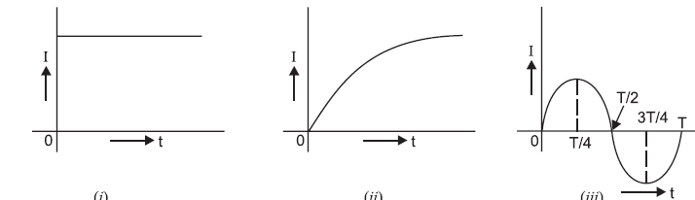
Types of Electric Current
Constant Current
Varying current
AC Current

Slide 19
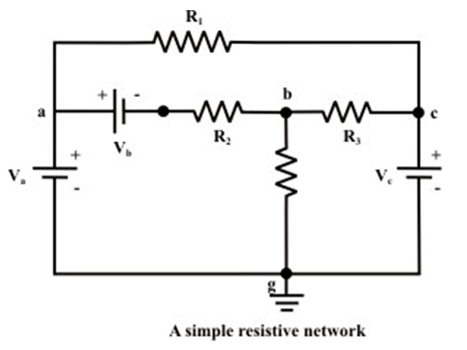
Objective of Network Analysis
To have voltage and current across each element
Number of unknowns = 2 x number of elements

Slide 20
Kirchhoff's Voltage Law (KVL)
The algebraic sum of voltages around each loop is zero.
Beginning with one node, add voltages across each branch in the loop (if you encounter a + sign first) and subtract voltages (if you encounter a – sign first)
Σ voltage drops - Σ voltage rises = 0
Or Σ voltage drops = Σ voltage rises

Slide 21
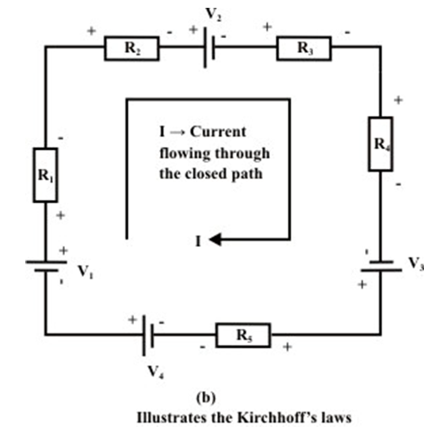
Kirchhoff's Voltage Law (KVL)
-V₁ +I.R₁ +I.R₂ + V₂ + I.R₃ + I.R₄ -V₃ + I.R₅ -V₄ = 0
OR
+V₁ -I.R₁ -I.R₂ - V₂ - I.R₃ - I.R₄ +V₃ - I.R₅ +V₄ = 0

Slide 22
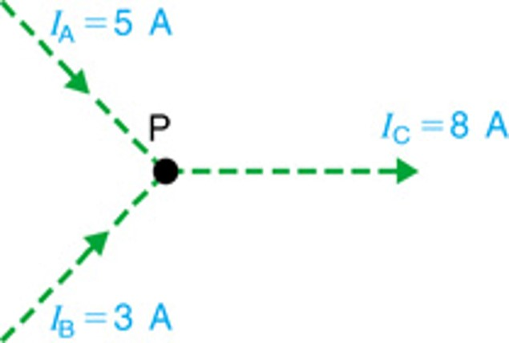
Kirchhoff's Current Law (KCL)
The algebraic sum of currents entering a node is zero.
Add each branch current entering the node and subtract each branch current leaving the node
Σ currents in - Σ currents out = 0
Or Σ currents in = Σ currents out

Slide 23
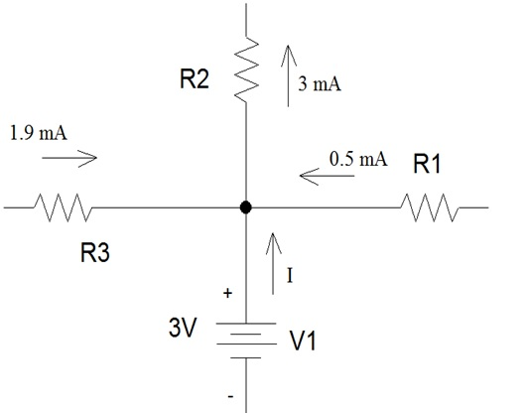
Example
Q: Determine I, the current flowing out of the voltage source.
Answer:
1.9 mA, 0.5 mA, I are
entering the node.
3 mA is leaving the node.
1.9 + 0.5 + I – 3 = 0
So I= 0.6 mA

Slide 24
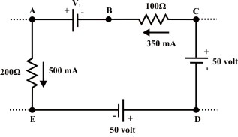
Problem
Calculate the potential of points A, B, C, and E with respect to point D. Find also the value of voltage source V₁.
Writing KVL around D-E-A-B-C-D:
V_{ED} + V_{AE} + V_{BA} + V_{CB} + V_{DC} = 0
-50 + 100 - V₁ + 35 – 50 = 0
V₁ = 35 V

Slide 25
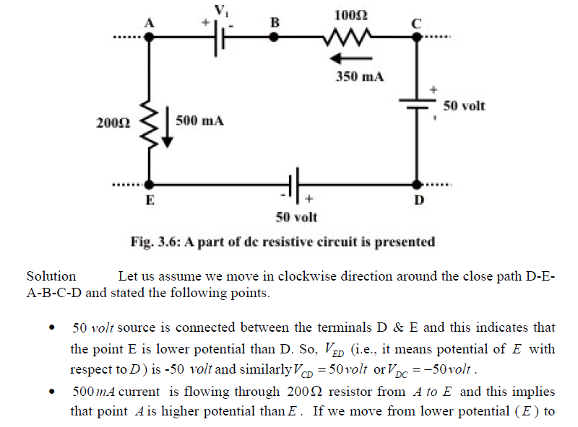

Slide 26

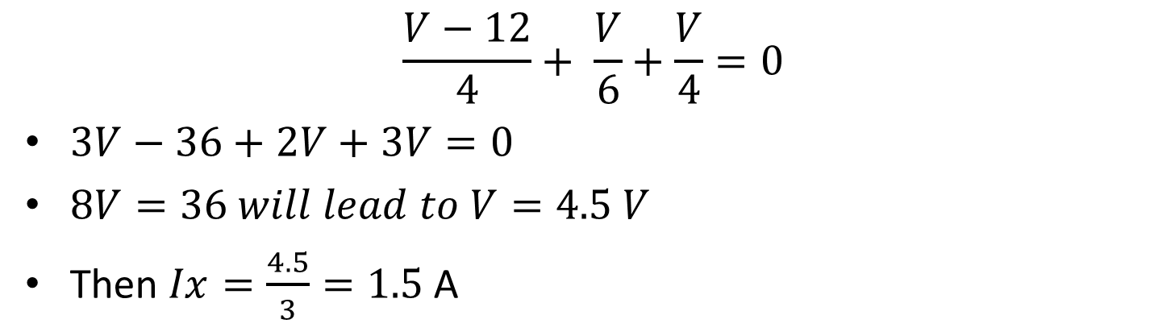
Example (KCL)
$$\frac{V−12}{4}+ \frac{V}{6}+\frac{V}{4}=0$$
$3V−36+2V+3V=0$
$8V=36 will lead to V=4.5 V$
Then $Ix=\frac{4.5}{3}=1.5$ A

Slide 27
Summary
Electrical Network
Passive Element
Active Element
Bilateral Element
Unilateral Element
Meaning of Response
Linear and Non-linear Circuits
Network Basics (KCL and KVL)

